Slide 1
Comprehensive Exam
-updated document
Name : Sharmila Mani
ID : Ph2020017
Committee Members : Prof. V Ramasubramanian
Prof. Neelam Sinha
Prof. Madhav Rao

Slide 2
1. Given a 1D time signal such as EMG signal acquired from two channels (two electrodes) separately, for 1000 seconds from an individual with sampling rate of 200 Hz for two physically separate events being repeated continuously. Consider five handcrafted features are extracted from the individual 1D time signal for each channel for a moving non-overlapping window of size 100 samples, where both channels are equally important
How do you intend to develop the classification model using any of the traditional Machine learning techniques? CNN or MLP models are not required for this analysis.
Classification Model can be developed using multistep procedure that include Data Collection, Data Preparation, Model Selection, Model Training, Model Evaluation, Parameter Tuning and Model Deployment
Data Collection – is where EMG signal is acquired from two channels when the classification task is performed
Data Preparation – helps to clean the data and visualize to understand the relationship between variables and parameters
Feature Extraction – helps to preserve the required information from raw data
Model Selection – the algorithm suitable for the classification can be chosen to train the data
Model Training – involves training the prepared data using the chosen algorithm. Algorithm learns the patterns in classification task from data provided and predicts the unseen data
Model Evaluation – Trained model can be evaluated using the data unseen to identify how well the algorithm performs
Parameter Tuning – helps to fine tune the model to provide best accuracy
Model Deployment – now the model can be used for classification task and it can help us to make well formed decision on a new data

Slide 3
b) Analyze the importance of the duration of the analysis-window (frame-size, e.g. 100 samples as indicated above or other possible choices of this size) - with respect to the desired time-resolution of labeling the signal and the trade-off in extracting reliable features (such as time-domain / spectral features) possibly calling for longer frame-sizes.
The total duration of the experiment here involves 1000 seconds and features are extracted from 100 samples.
Given 1000 seconds and sampling rate of 200Hz the total number of samples generated in a trial for single electrode is 2*10⁵ samples. In longer frame size extracting only five features from 200000 samples provides only the general information. The signal features has a large variability in the given time based on action performed which remains not captured. The long frame signals are sufficient to provide information when emg signal considered is stationary and do not have much variations. Based on action performed and its time taken, the complete trial can be split in shorter frames like 100, 200, 400 etc and analysis can be performed to identify which short frame size best suits for the given classification task. When the signal is dynamic the long frame signals are less likely to grasp the variations and the information gets lost. Hence in these scenario it is wise to use short frame signals.
c) Analyze the discriminatory power of any feature-set (e.g. the 5 handcrafted features referred above), and how one can
i) ensure the most optimal discriminability via feature-engineering (refer to classical feature-selection techniques),
The feature selection methods involve filter, wrapper and embedded methods.
Filter Method :
It involves considering all features at first and discarding features not useful one by one based on properties like information gain, chi-square test, fisher’s score , correlation, variance etc
Wrapper Method:
Wrapper method trains the algorithm iteratively and at each iteration conclusion is made on the subset of features. The conclusion on selection is done either by trainer or number of features required. The different approaches include Forward Selection, Backward Elimination, Bidirectional elimination, Exhaustive selection and Recursive elimination

Slide 4
Embedded Method:
Embedded methods blends Filter and Wrapper method and embeds feature selection part of learning process. Examples include Regularization and Tree based methods like Random Forest etc
ii) adapt means towards how best to 'hand-craft' the features, i.e., what considerations go into deciding on the choice of features (time/frequency domain or other kinds, if any).
Time domain features are calculated from the amplitude of the signal and helps to identify stationary features like mean, variance, standard deviation, skewness, kurtosis etc. Frequency domain features helps to identify discriminability of the frequency variation in the actions by features like mean frequency, median frequency, signal to noise ratio etc.
Handcrafting can be done by classification based on individual features and select features that provide good results. The features combinations that provide good information on the task and good accuracy is considered. The ones with high correlation can be removed. Two main approaches involved include incremental and decremental method. Incremental method involves starting from single feature and adding feature one by one. Decremental method involves having all features and removing feature one by one if they do not add any value.
d)Since the available data is limited, in order to establish generalizability, Use Hypothesis Testing to establish the statistical significance of the results obtained, for a reasonable value of parameters.
Hypothesis Testing is done to confirm our observation on the population using sample extracted from the population. It helps to find how the trained model performs on the data. The data used for evaluation can ensure to have all the different classes and significance of alternate hypothesis can be defined.
The steps involved in hypothesis testing include
1. Define null hypothesis i.e. no relation between variables and alternate hypothesis i.e. initial hypothesis that predicts relationship between variables. Null and alternate hypothesis are mutually exclusive i.e only one can be true at a time.

Slide 5
2. Collect data which is sample of the population and perform statistical test that compares within group variance and across group variance. The test starts with an assumption null hypothesis is true. Based on the outcome Low p-value shows across low within group variance and high across group variance. Contrary high p-value shows high within group variance and low across group variance. The statistical significance α denotes the maximum risk of Type I error that is acceptable.
3. Decide to reject or fail to reject the null hypothesis based on p-value. p < α rejects the null hypothesis and the results are statistically significant.
Based on the data and output variable and data follows a normal distribution the test to calculate p-value will vary.
Statistical Evaluation can be done if
No autocorrelation : all variables are independent
Homogenity of Variance : variance within each group is similar among all groups
Data follows normal distribution
If data does not follow above then non-parametric tests like chi-square can be used.
The data can be
1. Quantitative ie. Continuous or Discrete
2. Categorical ie. Binary, Ordinal or Nominal
Test can be
1. Regression Test (to analyse cause and effect) : Simple Linear, Multiple Linear or Logistics
2. Comparision Test (to find different between group means) : T-test(one sample t-test, paired t-test, two sample t-test), ANOVA (one way anova, multi-way anova)
3. Correlation Test (to check variables are related) : Pearson’s r

Slide 6
Regression Test
Comparison Test
 | Predictor variable | Outcome variable
Paired t-test | Categorical 1 predictor | Quantitative groups come from the same population
Independent t-test | Categorical 1 predictor | Quantitative groups come from different populations
ANOVA | Categorical 1 or more predictor | Quantitative 1 outcome
MANOVA | Categorical 1 or more predictor | Quantitative 2 or more outcome
 | Predictor variable | Outcome variable
Simple linear regression | Continuous 1 predictor | Continuous 1 outcome
Multiple linear regression | Continuous 2 or more predictors | Continuous 1 outcome
Logistic regression | Continuous | Binary

Slide 7
NonParameteric Test
 | Predictor variable | Outcome variable | Use in place of…
Spearman’s r | Quantitative | Quantitative | Pearson’s r
Chi square test of independence | Categorical | Categorical | Pearson’s r
Sign test | Categorical | Quantitative | One-sample t-test
Kruskal–Wallis H | Categorical 3 or more groups | Quantitative | ANOVA
ANOSIM | Categorical 3 or more groups | Quantitative 2 or more outcome variables | MANOVA
Wilcoxon Rank-Sum test | Categorical 2 groups | Quantitative groups come from different populations | Independent t-test
Wilcoxon Signed-rank test | Categorical 2 groups | Quantitative groups come from the same population | Paired t-test
Ref:
https://www.scribbr.com/statistics/statistical-tests/
https://www.analyticsvidhya.com/blog/2019/09/everything-know-about-p-value-from-scratch-data-science/
https://medium.com/analytics-vidhya/hypothesis-testing-analysis-of-variance-anova-52c3df0fbc80
https://towardsdatascience.com/hypothesis-tests-explained-8a070636bd28

Slide 8
Implication of T-test and ANOVA for our experiments:
Our experiments consist of instant key press are for all five fingers i.e 5 classes with each class consist of 60 trials. The features are extracted from all 300 trials with full frames or short frames with 50% overlap. The extracted features are standardised and LDA is applied to reduce dimension. The dimensionality reduced data is classified using Random Forest and evaluated with k-fold (k=10) cross validation.
For the concern of small dataset hypothesis testing we do have plans to include t-test for 2 finger classification and ANOVA for 5 finger classification.

Slide 9
Backup

Slide 10
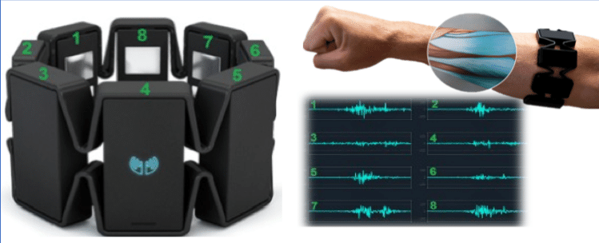
Please discuss and explain the CNN and Random-Forest method employed for your research work towards identifying finger-based keypress using surface-based EMG signals in detail. Highlight the major results accomplished so far in the research work.
Objective: To decode continuous playing of musical instruments like electronic musical keyboard, piano using EMG signal from hands.
Data Collection :
C | D | E | F | G
T | I | M | R | L
Key Press : 10 second
#Trials : ~31 trials for each class
#samples/trial : 2270
#classes : 5
Myo armband : 8 Electrode data
Using Bluetooth and MyoConnect

Slide 11
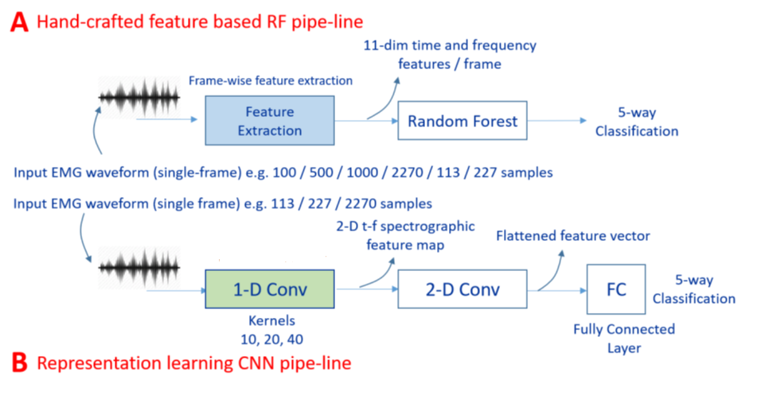
Architecture Pipeline:

Slide 12
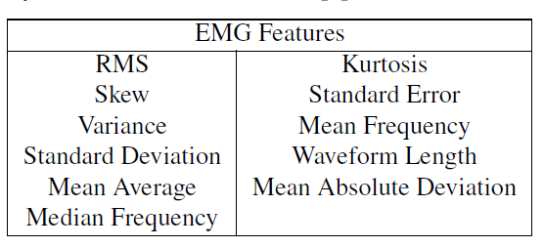

Analysis: RF Pipeline
Feature Extraction
Standard Scaler
LDA
Classification Accuracy for different frame size using All 8-electrode EMG data in RF pipeline.
RF
Experiments on CNN: #1, #4 and #7
Single Electrode Full Frame EMG data in RF pipeline.
Electrode #1 and #7 : highest, #4 and #6 : lowest

Slide 13
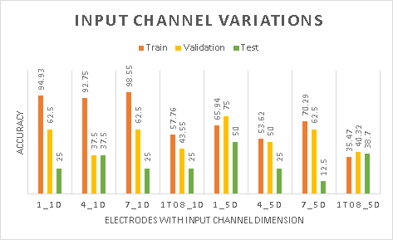
Analysis: CNN Pipeline
Single vs Multiple Channel, Short and Full Frame Analysis, Different Kernel Size
Data Split : train:validation:test , 8:1:1 and 7:1:2
Classification accuracy of key press classes using single electrode (#1, #4, #7) data, and all electrodes (1To8) data when applied to single channel and multiple 5 channels of CNN input in CNN pipeline

Slide 14
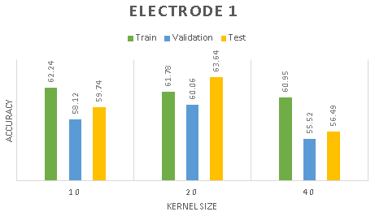
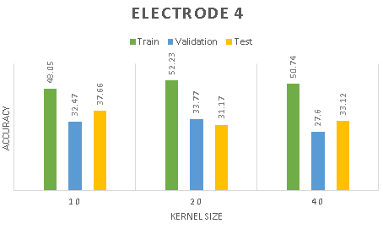
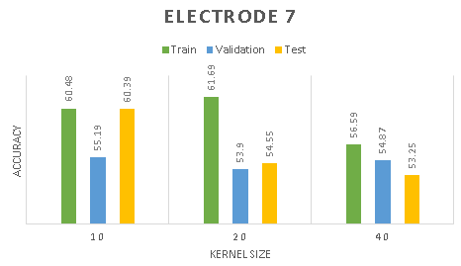
Analysis: CNN Pipeline
CNN train, validation and test accuracy for varying kernel sizes and frame size of 227 for single EMG Electrodes (#1, #4 and #7) data.

Slide 15
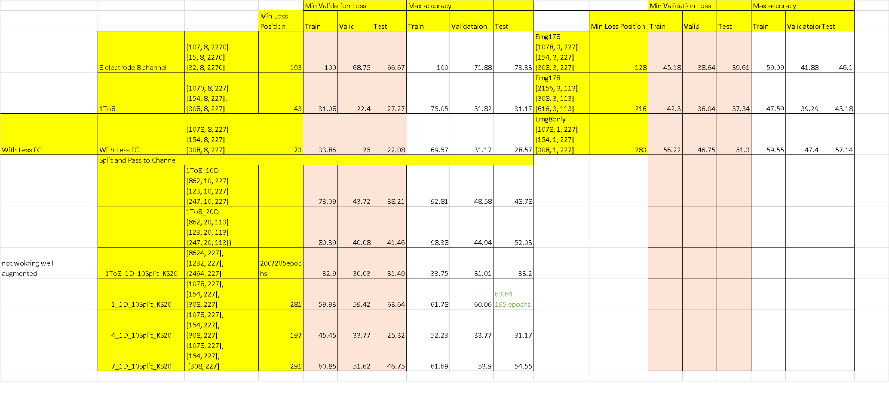
MultiChannel vs Single Channel

Slide 16
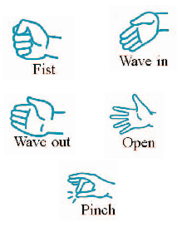
Ongoing: CNN Analysis for Myo and Standard Data Gestures
Myo Gestures
Six Grasping Gestures DataSet
To compare
- raw features [11D, opensmile] vs Spectral Analysis vs CNN
- long press of 10 second vs instant key press vs multiple key press
Future:
- Key Press to Continuous Decoding
- Single user to Multi user

